Slide 1

Exploratory Data Analysis
G2M insight for Cab Investment firm
21/02/2024

Slide 2

Agenda
Executive Summary
Approach
EDA
EDA Summary
Recommendations

Slide 3
Summary – G2M strategy for cab investment
Understand the market before investing in the cab sector using the Go-to-Market (G2M) method.
Go-to-market strategies typically focus on short-term objectives, but good ones evaluate how any initial success may be sustained in the long run.
Steps involved:
Data Understanding & Preparation
Exploratory Data Analysis (EDA)
Profit & Demand Analysis
Recommendations

Slide 4
Data Understanding & Preparation
Time period of dataset - 31/01/2016 to 31/12/2018
Final dataset retrieved by merging of 4 interconnected datasets.
Final dataset includes 35k rows and 14 features
Data pre-processing steps undertaken:
Merged the interconnected datasets to get the final raw dataset.
Checked for null and duplicate values
Year is extracted from date column for easiness.
All the object data type is made to category type.

Slide 5
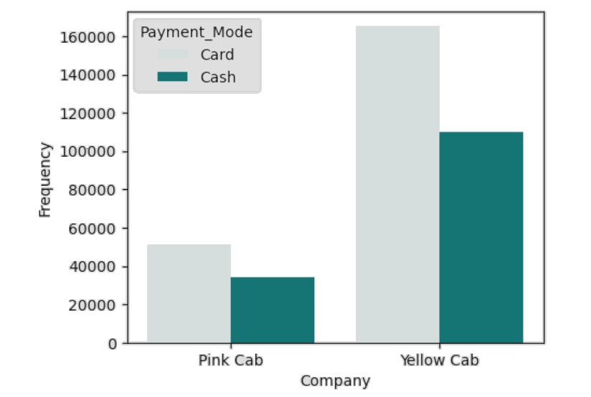
Company and Payment mode Analysis
The choice between card and cash transactions may reflect customer preferences.
Yellow cab has higher card transaction rate indicating they are technologically advanced.
Indicate that Yellow cab serves a broad spectrum of customers with varying payment preferences.
Yellow cab might have invested in efficient systems that allow for seamless processing of both card and cash transactions.

Slide 6
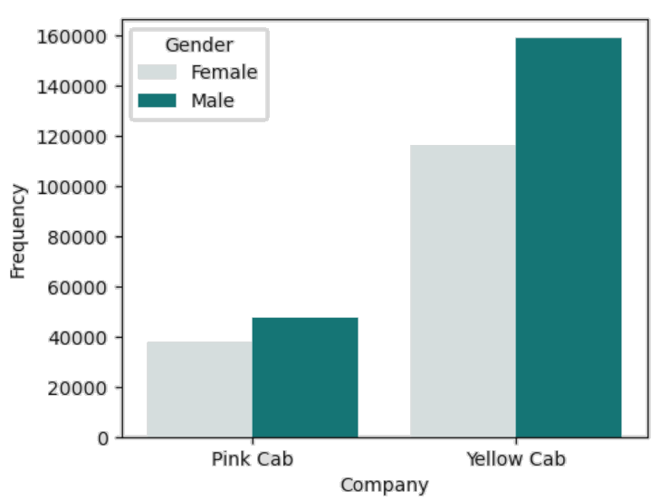
Company and Gender Analysis
From the graph it can be seen that customer base is higher for yellow cab than pink cab.
Building a brand that is inclusive and relatable to a diverse audience can enhance market appeal.
The higher number of male consumers can be due to the population base.
The marketing and branding strategies employed by both companies may inadvertently target or resonate more with male consumers.

Slide 7
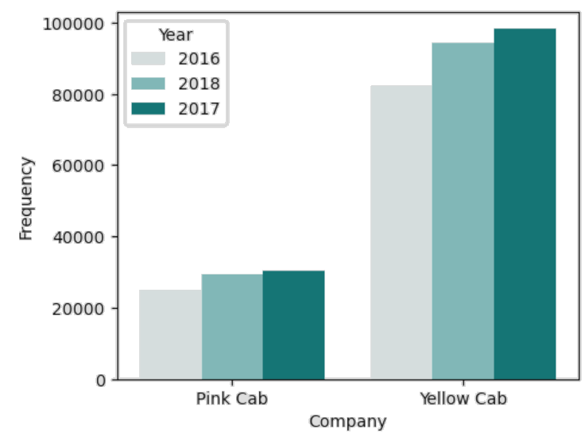
Yearly Cab Users Analysis
The increase in cab usage from 2016 to 2017 suggests potential market growth.
The graph suggests that the customer base of yellow cab is minimum 3 times higher than pink cab.
Higher usage in 2017 may be attributed to increased customer satisfaction or loyalty, potentially due to improved service quality or better user experiences.

Slide 8
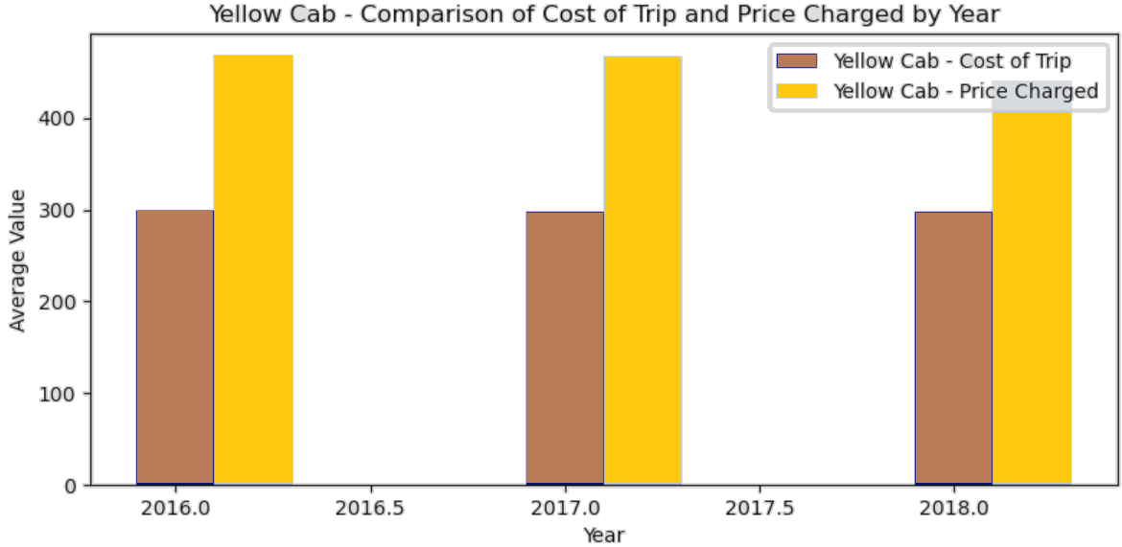
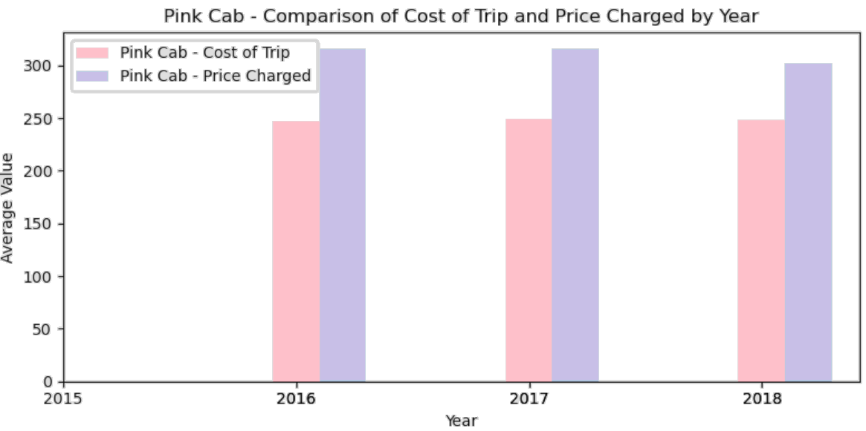
Profit Analysis

Slide 9
Recommendations
Yellow cab has almost 3 times higher customer reach than pink cab.
Customers choose yellow cabs because they may offer advanced payment methods or several payment modes, which attract a wide range of customers.
Yellow cab has higher number of customers from both genders especially male when considering male/female Gender reach which shows that yellow cab must be more inclusive as they are preferred more.
Average profit is also 3 times higher for yellow cab when comparing their profit analysis.
From the above analysis and insights, we will recommend yellow cab for investment.

Slide 10
Thank You

